Slide 1

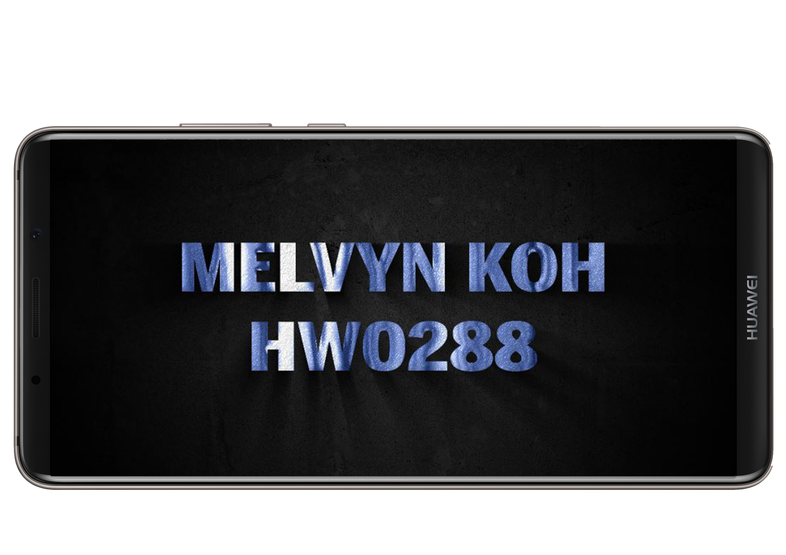

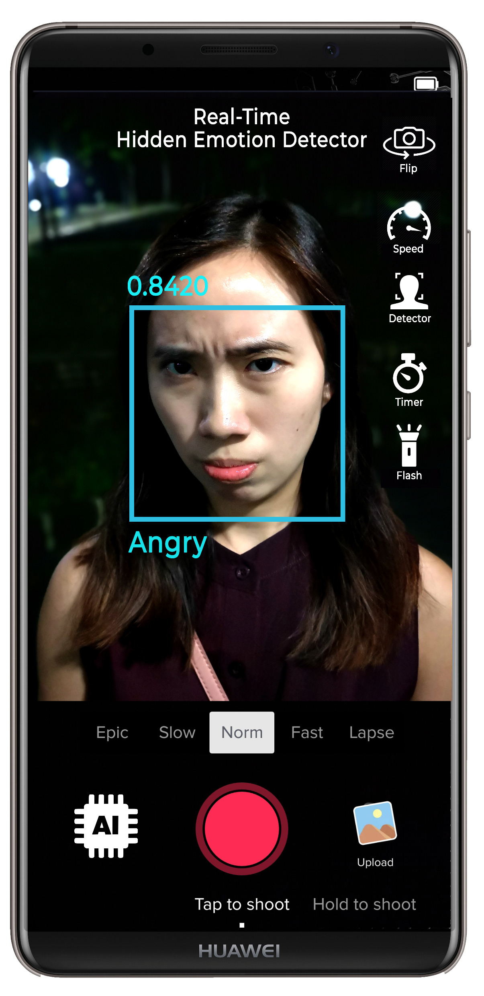
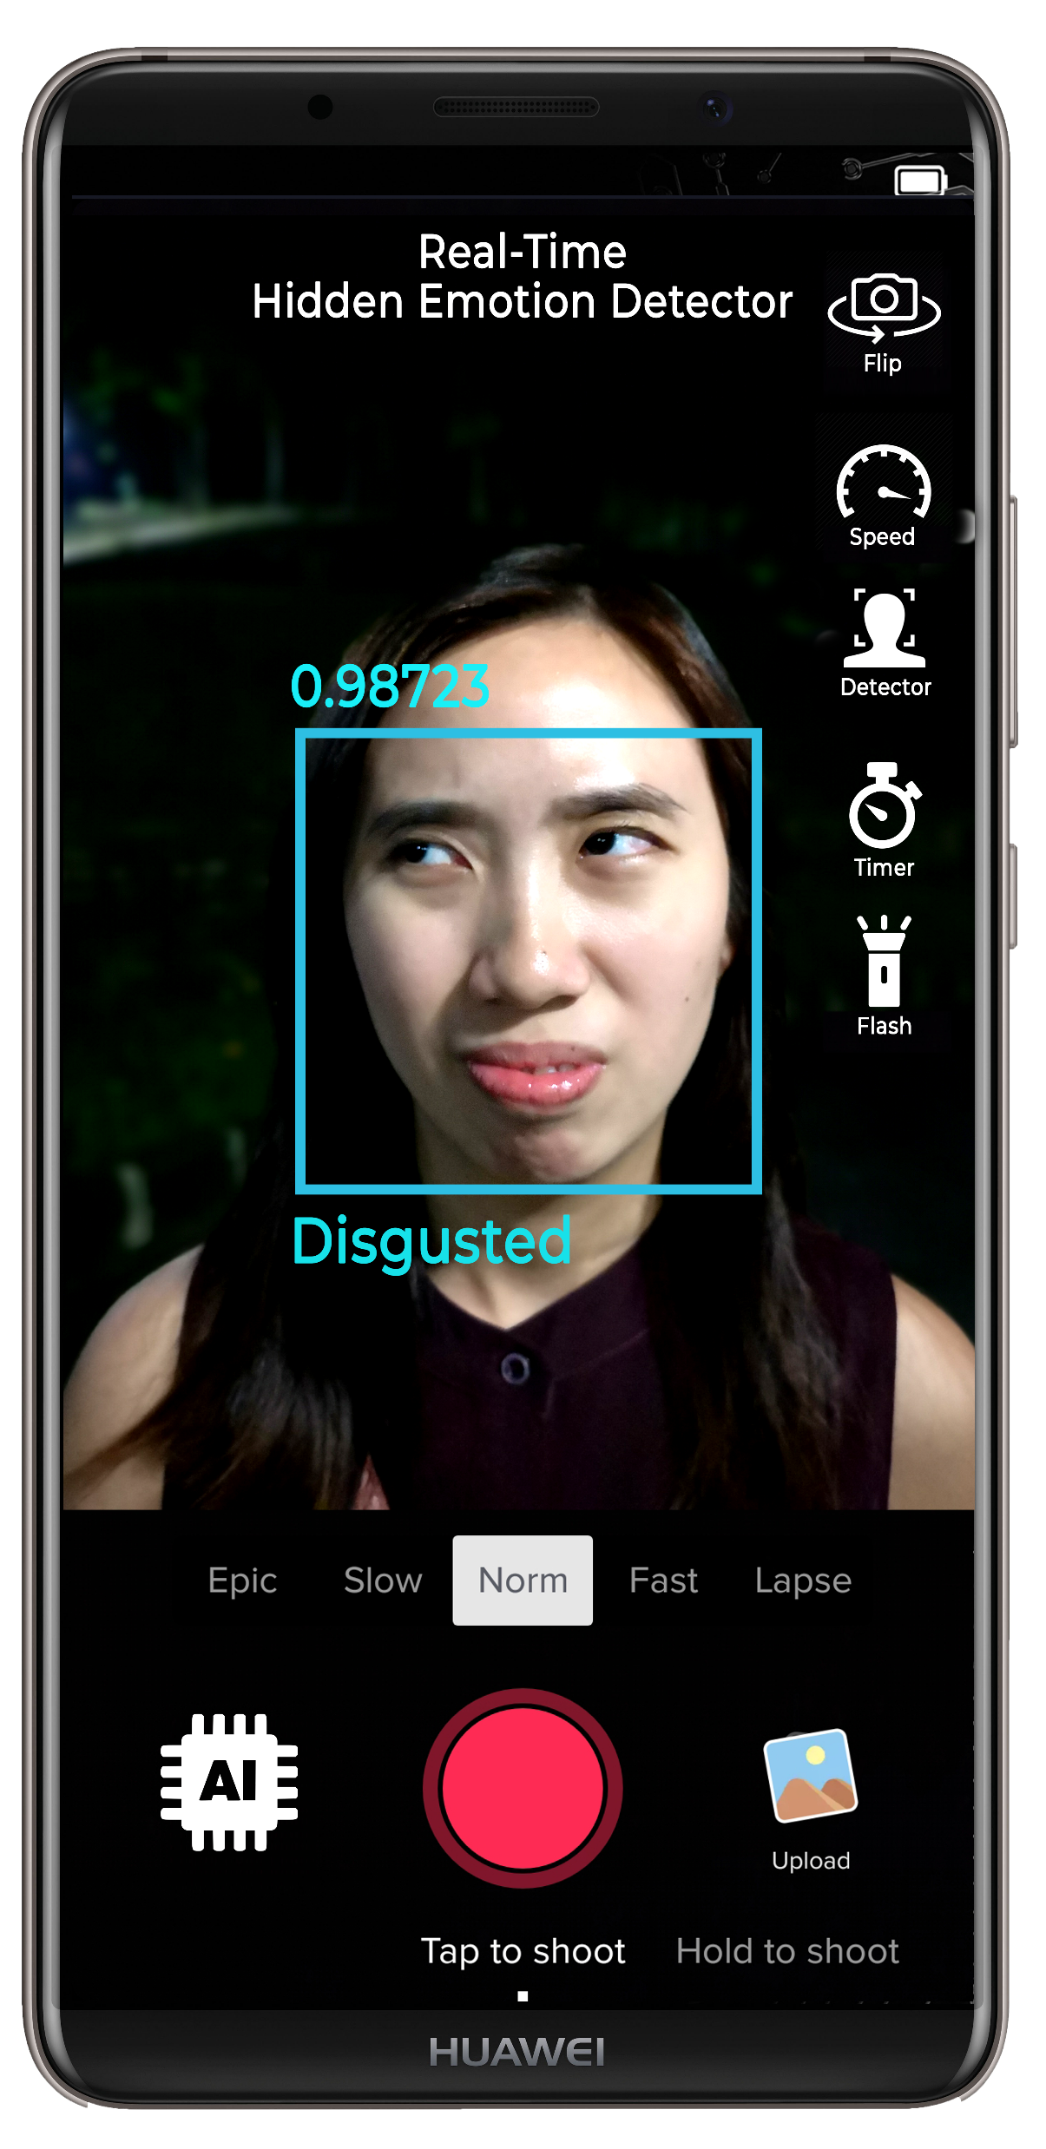
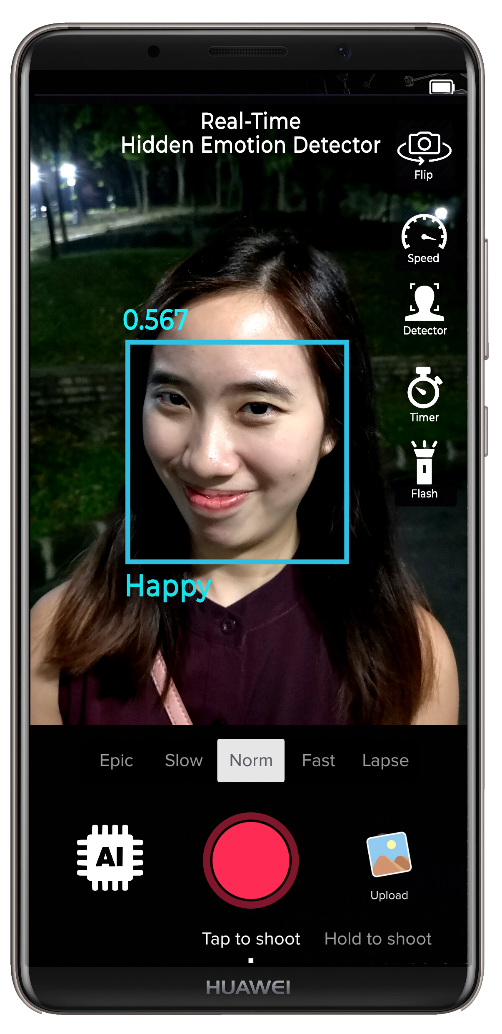

Real-Time
Emotion Detection
Real-Time
Hidden Emotion Detection

Slide 2
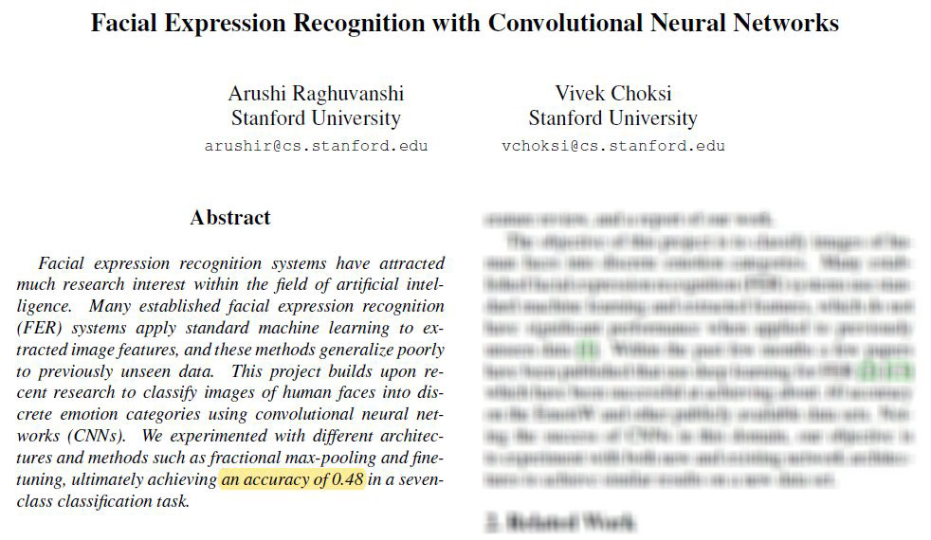

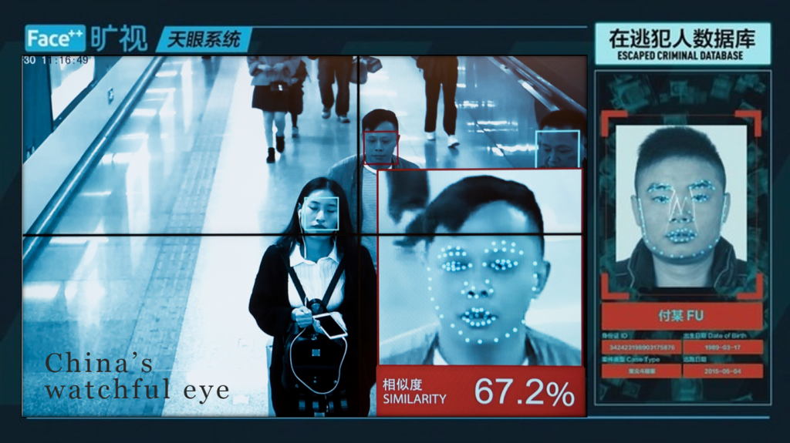
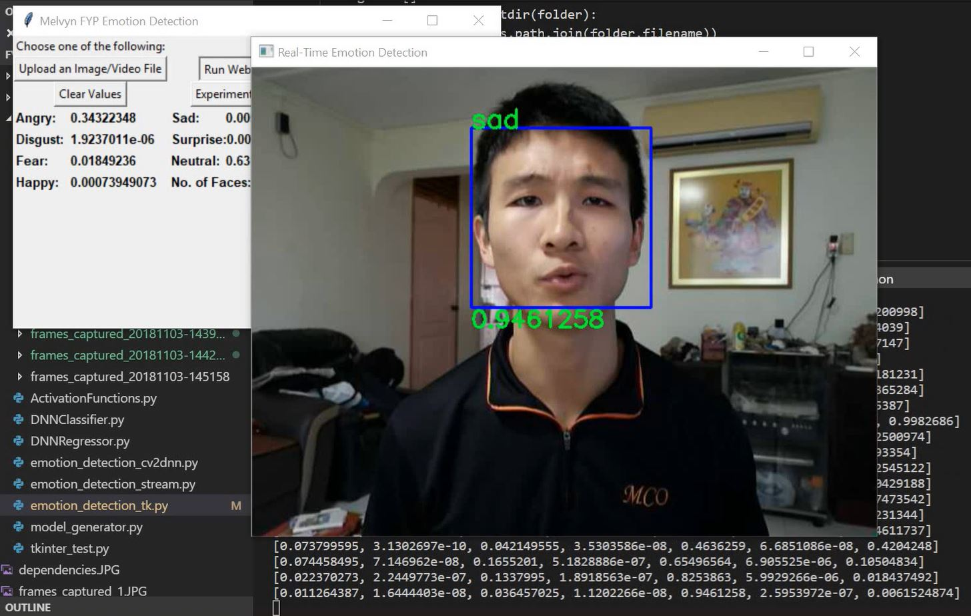
Research Gap
While technologically-advanced countries like China have resorted to using facial recognition as a smart surveillance system capable of scanning 2 billion faces within seconds, not much has been explored in the field of emotion recognition
Recent Studies
Facial Recognition
Accuracy Rate: 99%
Emotion Recognition
Accuracy Rate: 48%

Slide 3
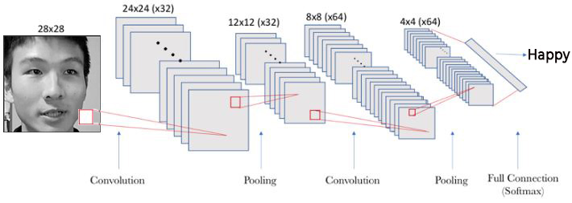
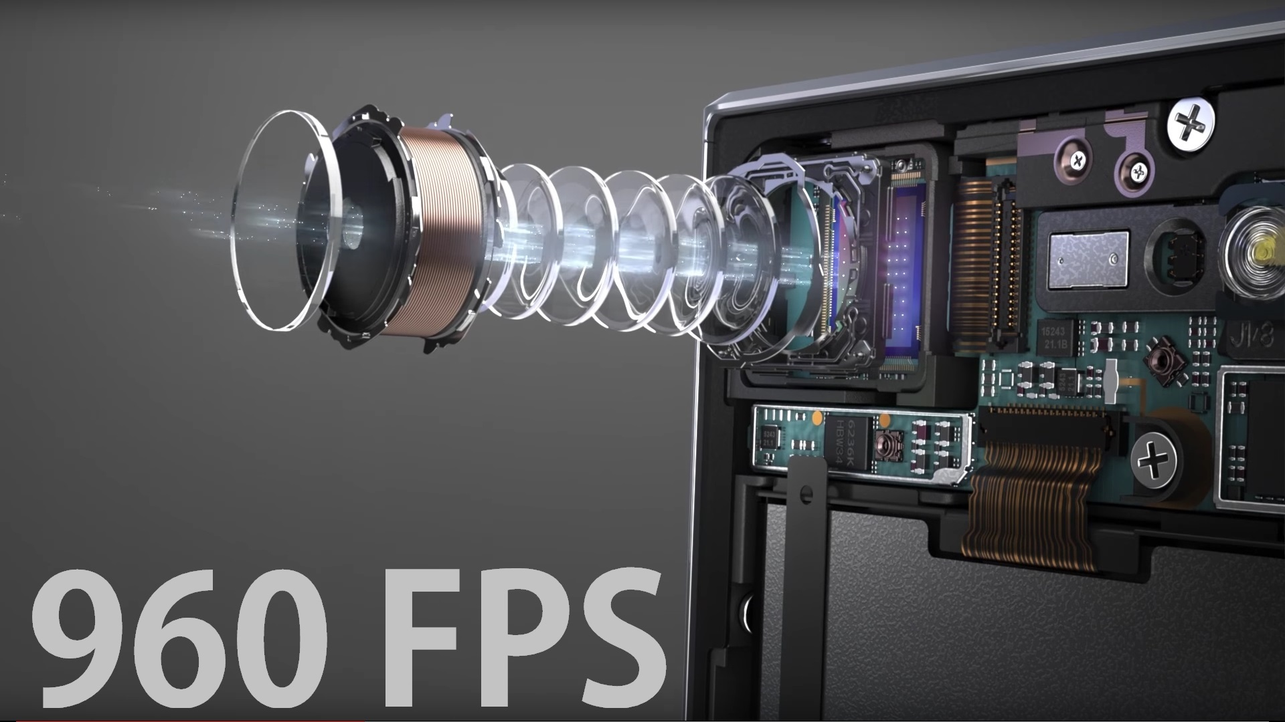


Objective
Create an emotion detection system that captures emotion in real-time with
55-60% accuracy rate
55-60% accuracy rate
CNN
2. System based on the CNN (convolutional neural networks) approach
Keras
3. Five convolutional layers were built using machine-learning technologies by Keras and Google’s Tensorflow to construct the trained model
Tensorflow
high-speed camera
4. Deployed on a high-resolution camera to accommodate for the better quality frames to capture any subtle facial movements

Slide 4
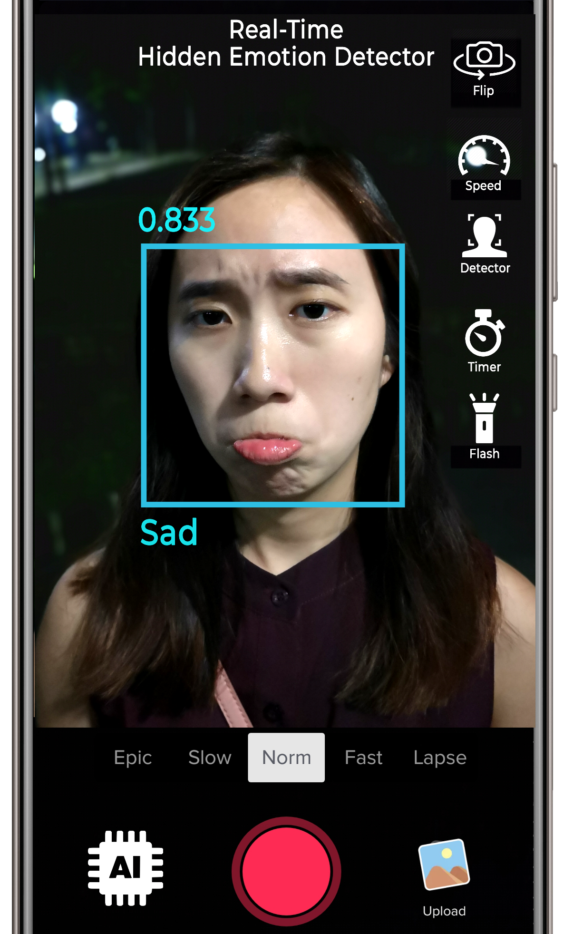
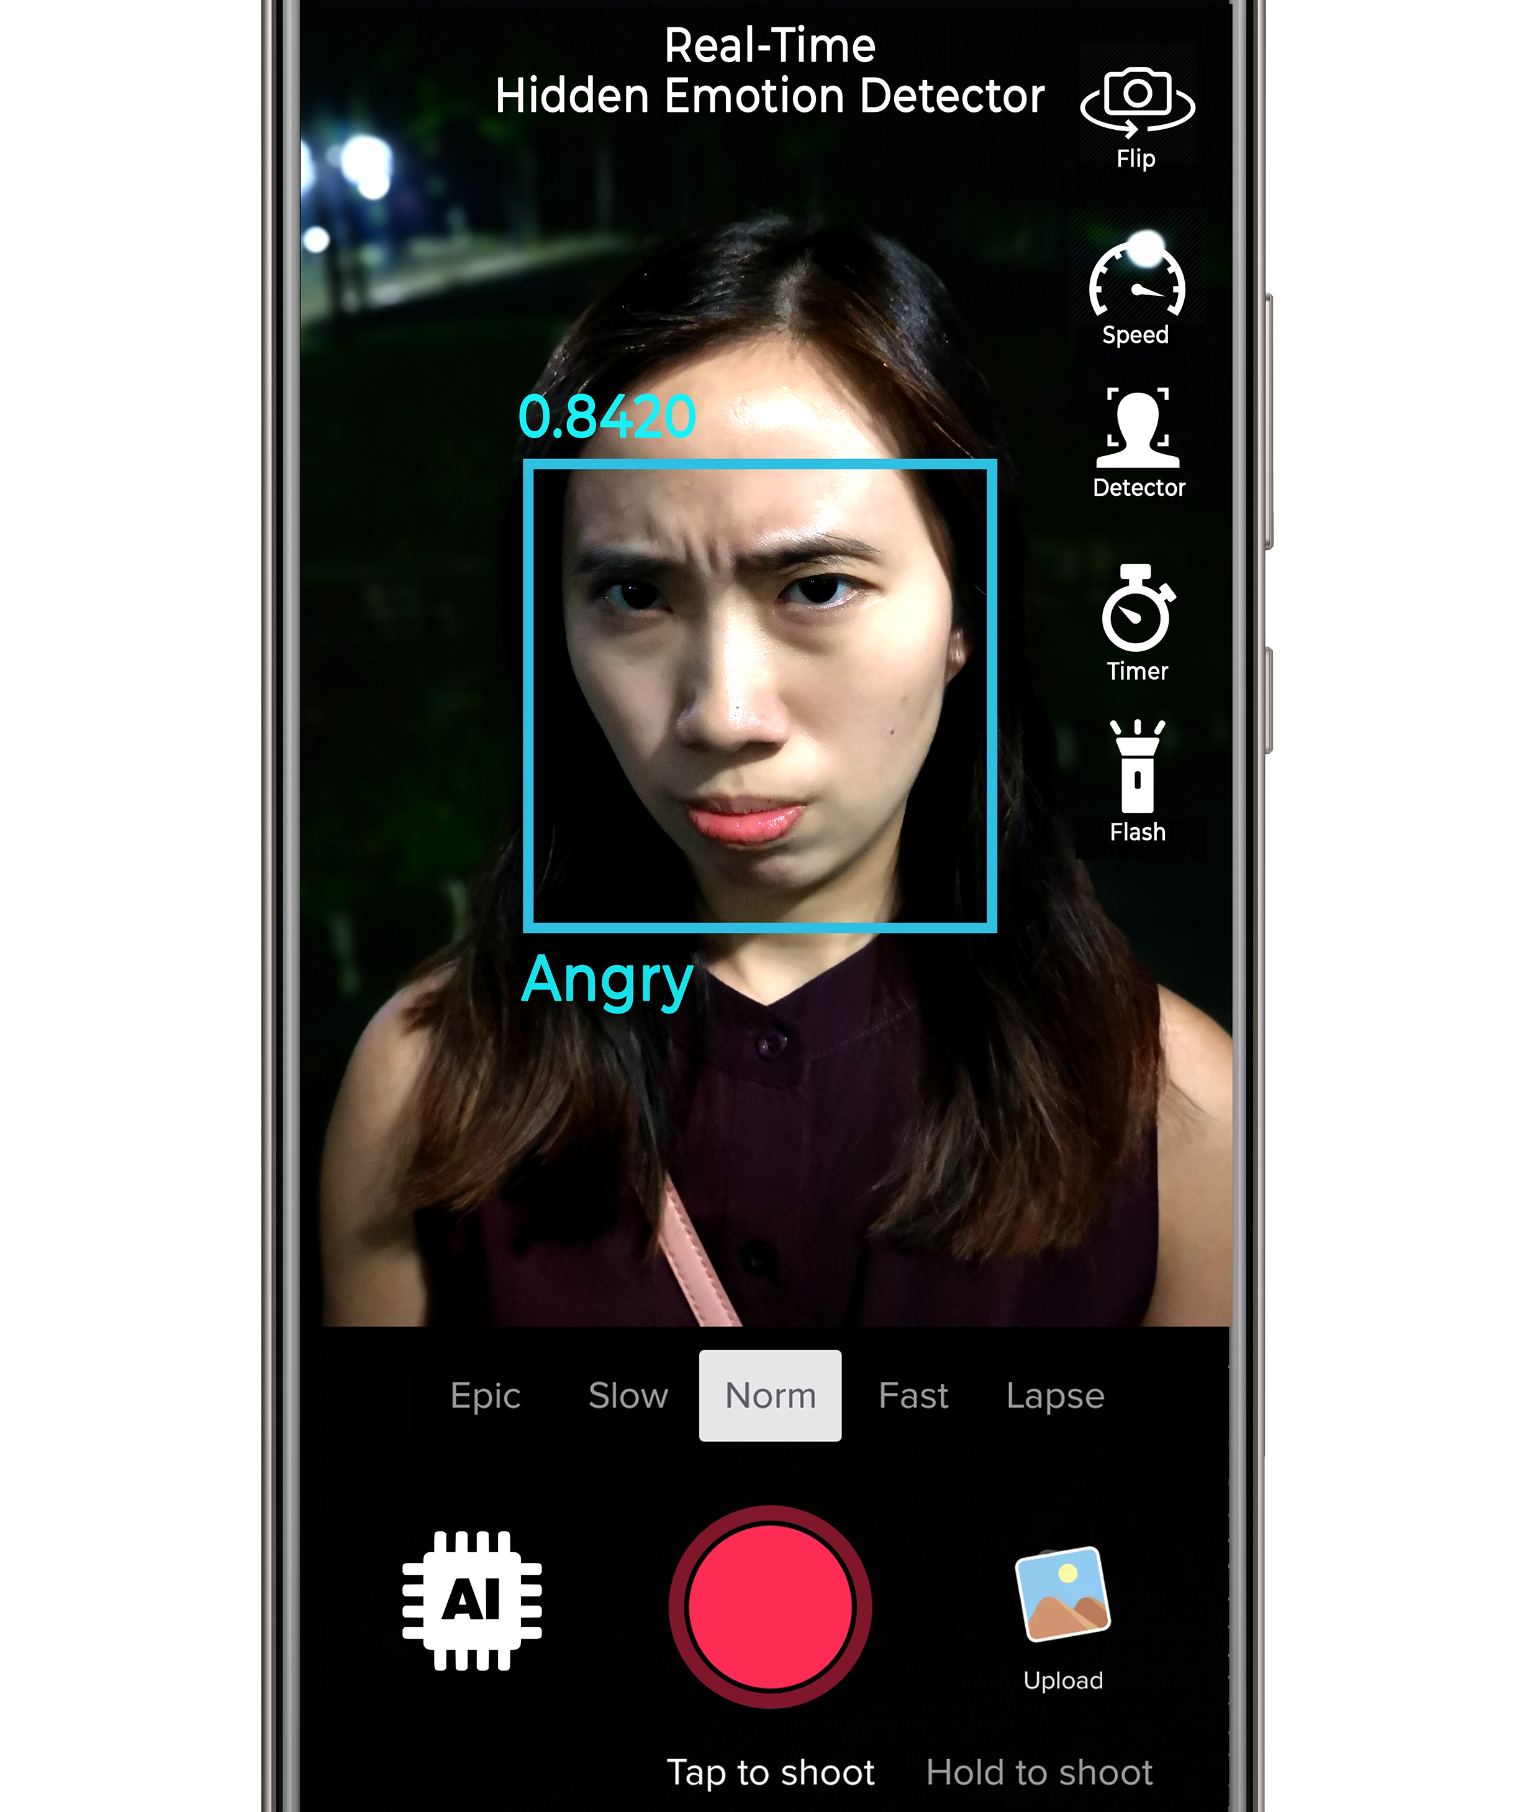
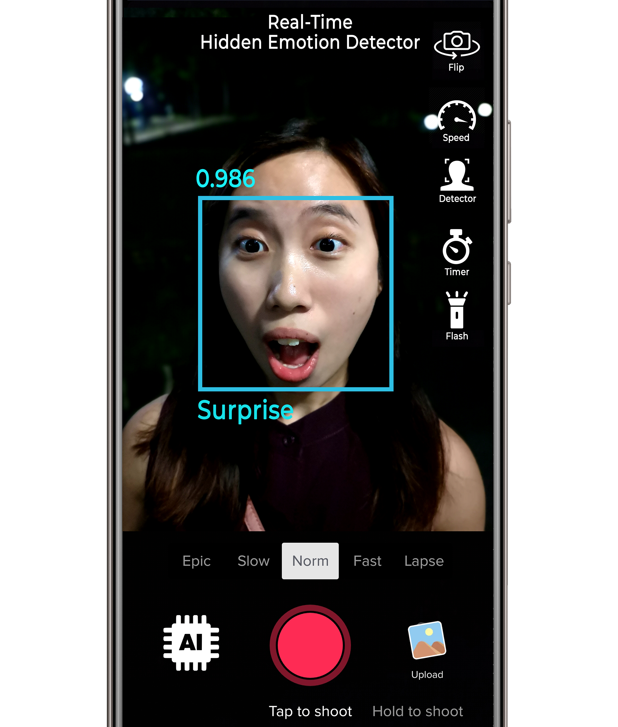
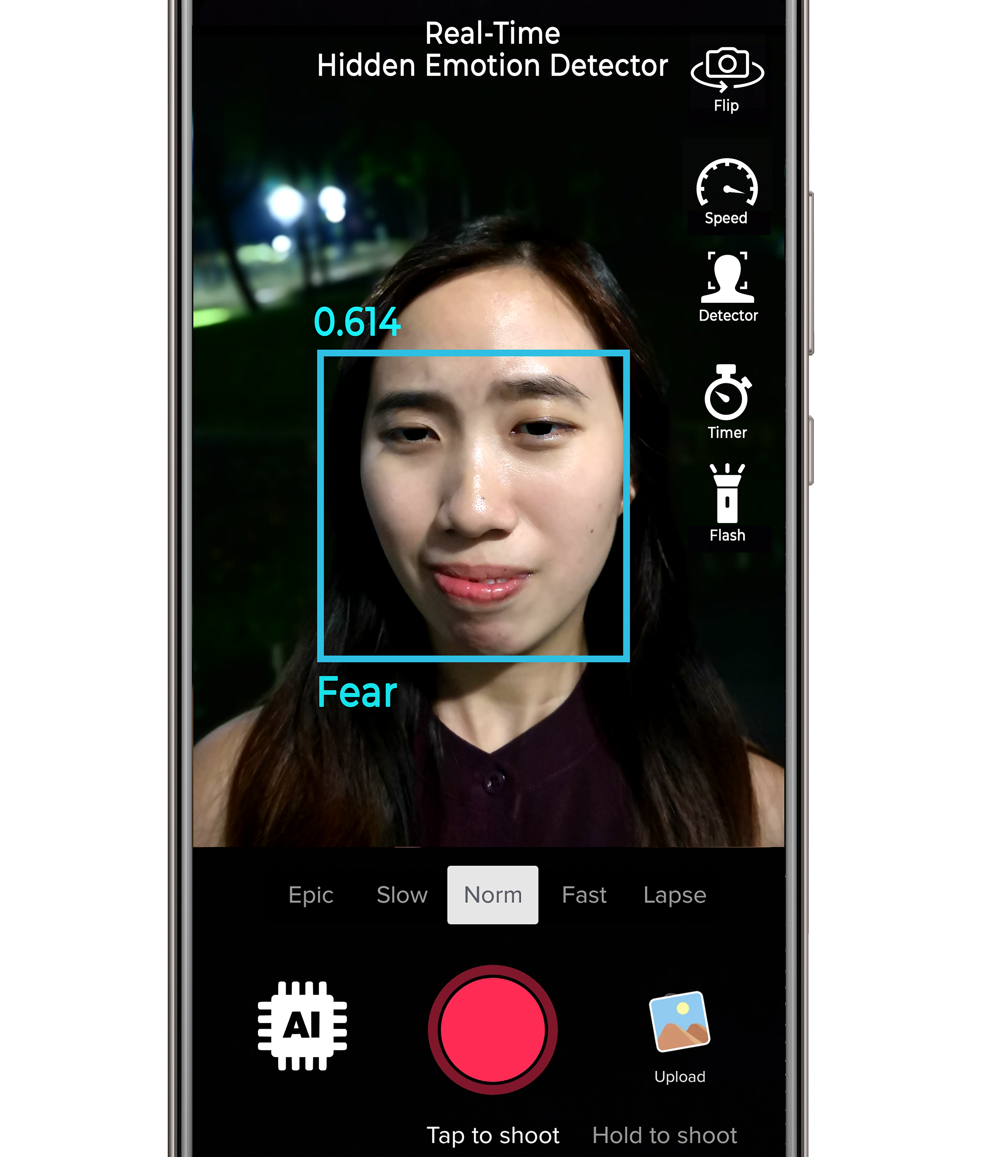
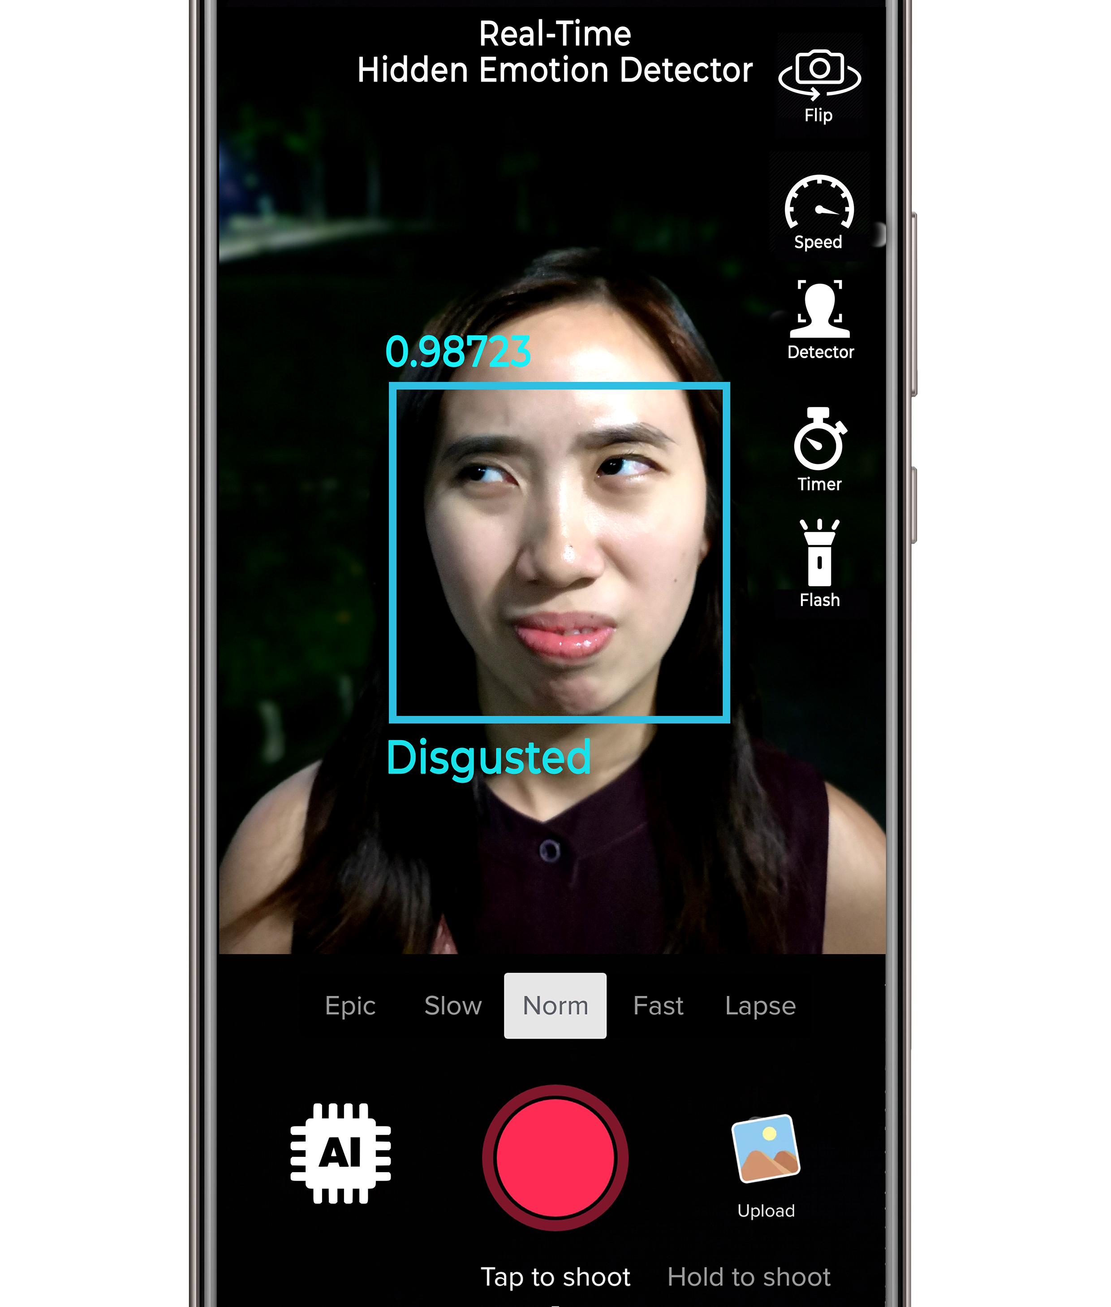
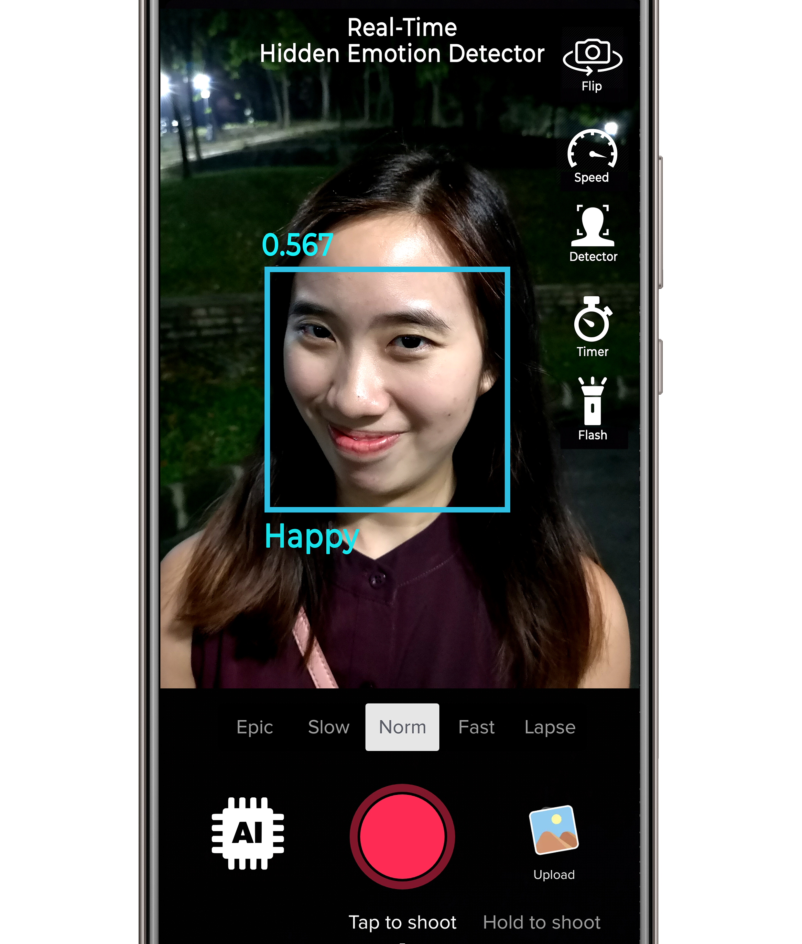
Scope
Classify 7 categories of emotions
Angry
Surprise
Angry
Surprise
Disgust
Fear
Disgust
Fear
Happy
Happy
Sad
Sad
Neutral
Neutral

Slide 5




Software Tools
Programming Language Used
- Python (Anaconda)
IDE
- Visual Studio Code
- Google Colab (free cloud service and fast GPU)
GUI Tools
- Tkinter

Slide 6
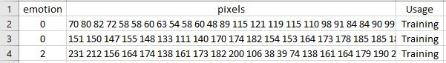
Datasets
1. Google Images
Google images as my training data with 200 images for each emotion
Extract images automatically with JavaScript snippets on the console in Google Chrome Browser
2. FER2013 (35,888 Images)
Published on International Conference on Machine Learning (ICML) in the year 2013
Used in Kaggle as a data science competition
Total Images: 35,888 | Training: 28,709 | Testing: 3,589
A CSV file with each row containing:
emotion label of each image
Pixel values
Usage type – ‘Training’ or ‘Testing’

Slide 7
Implementation
Constructing CNN with Keras
A 5-layer convolution network is created with rectified linear unit (ReLU) as the activation function for each hidden layer while SoftMax classifier is used at the final output layer
SoftMax because it normalizes outputs in the final layer in the scale of [0, 1] as the sum of outputs will always be equal to 1 (largest probability equals 1)
Applied on the very last stage (final layer) after flattening of the layer

Slide 8
Implementation
1st Convolution Layer
Since each image in the FER2013 has a dimension of 48x48 pixels, the input_shape is set as (48,48,1) with ‘1’ as the argument for the color channel depth of 1 as the images are all in grayscale
64 filters of window size 5x5
Max pooling layer with pooling window size 5x5
Strides (2,2) refers to the amount
the 5x5 window shifts 2 pixels at a time
in x,y direction

Slide 9
Implementation
2nd & 3rd Convolution Layer
Window size for the filters is decreased to 3x3 and the Average Pooling is used instead of Max Pooling
Due to loss in no. of pixels after each pooling, the number of filters is increased → 128 filters
Lastly, the model is flattened from a 3-D to a 1-D tensor before the SoftMax classifier is applied at the output layer
A single long 1-D feature vector is used by the dense layer for the final classification of the emotion label

Slide 10
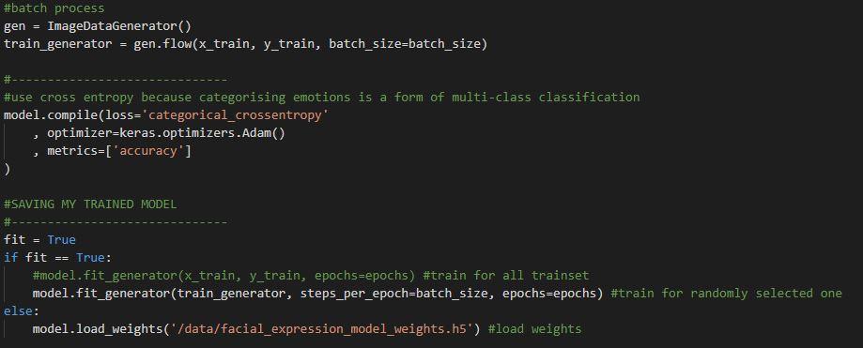
Implementation
Training Using Keras
Batch Size = 256; Epochs = 20; Number of Classes = 7;

Slide 11
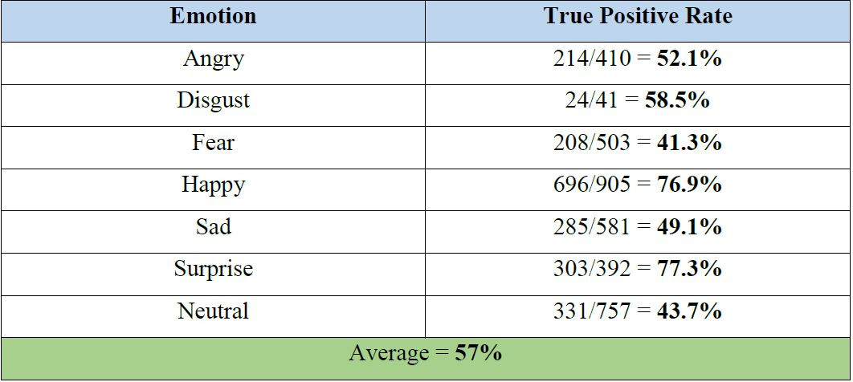
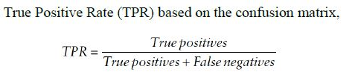
Implementation
Validations
Confusion matrix of the model that is tested on the test set
Highlighted in yellow are true positives
Ideal results → highlighted are non-zero value, while the rest are zero
Average = 57%

Slide 12
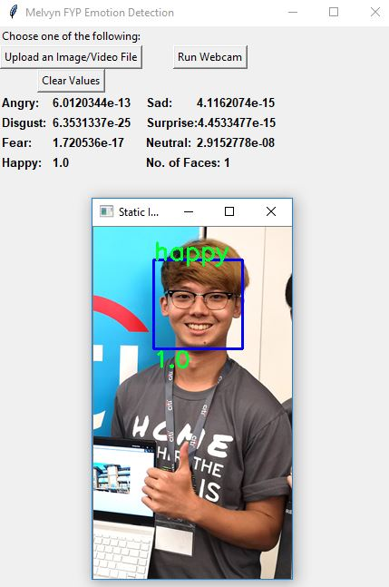
Implementation (Workflow)
Overall workflow on how the Python program, neural network and some of the functions/features provided in the application

Slide 13
Video Stream/ Real-Time
Using OpenCV library’s VideoCapture() function, it runs the laptop’s built-in webcam by default and a cv2 window will pop-up for live stream
A new folder is created, and the folder name is based on the current date and time
The emotion label with the highest probability is determined as the emotion predicted
At the same time, the image file is saved inside the folder that was created earlier on, with the frame number, emotion label and probability of that emotion saved as the file name.

Slide 14
Upload Static Image
Similar to real-time detection except that it uses OpenCV’s imread() function to read in the image file
Does not have to go through a loop since it only has one frame for detection
Bounding boxes are drawn on every face that is detected by the HAAR Cascade classifier
Location of the printing has to be in reference with the (x,y) origin of the bounding box where the top left corner is the origin (e.g. (0,0) )

Slide 15
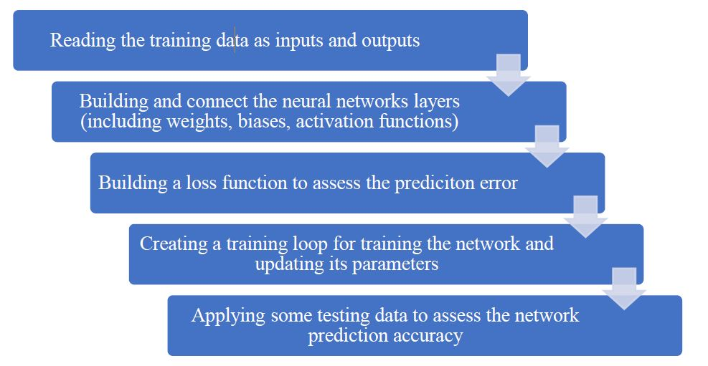
Implementation
Summary

Slide 16
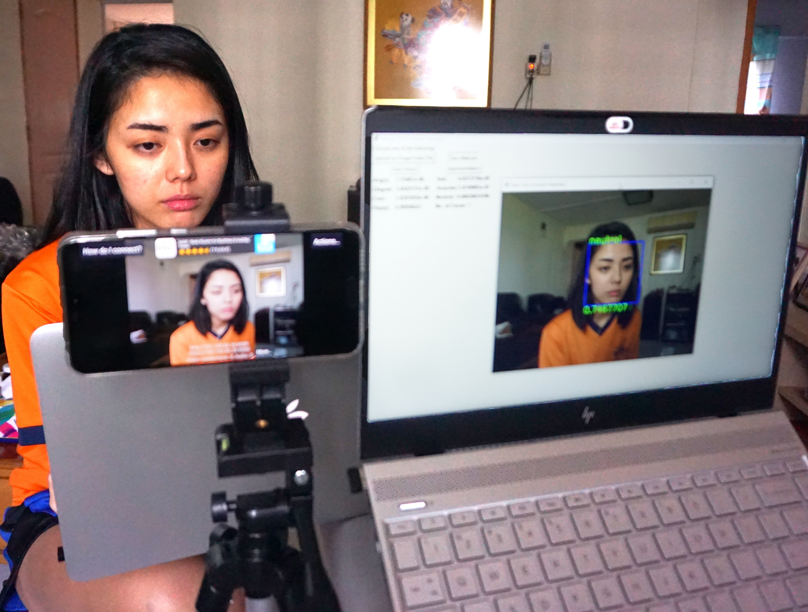
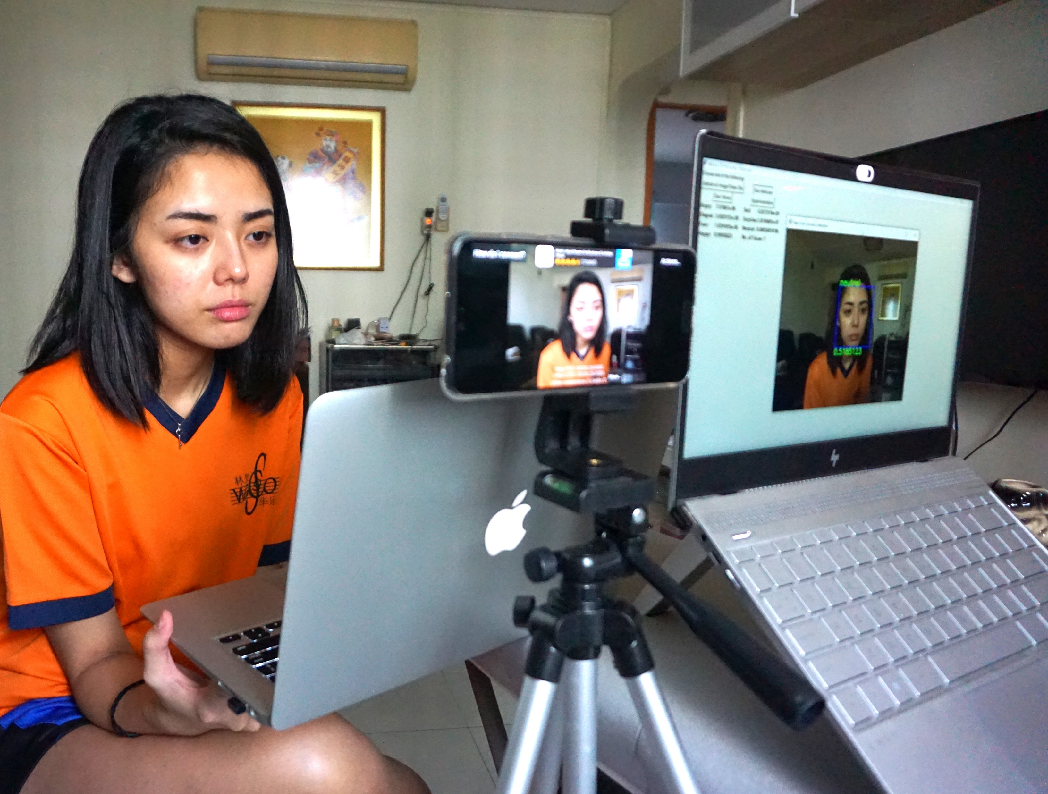
Experimentations
Setup
Test subject to watch a series of videos which are aimed to evoke certain emotions to evaluate the performance

Slide 17
Experimentations
Storing of Image Frames in Real-Time
Image frames captured are analysed by the model and stored automatically in a specific folder in real-time
Filename as
Frame number
Emotion Label
Confidence

Slide 18
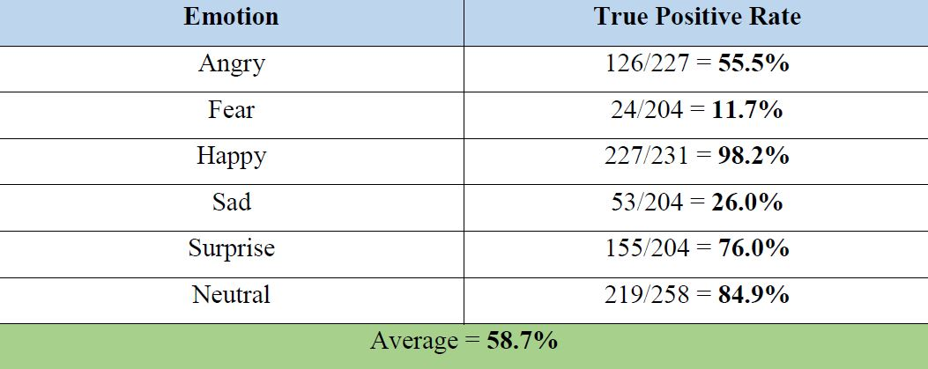
Results
The CK+ dataset was used in this experiment
Images of their emotions labelled are placed in their respective folder with the name of the emotion
App detects and classifies every image found in the folder
Each folder contains images of the same emotion
Average = 58.7%

Slide 19
Conclusion
System built has a good performance of 57-58% accuracy rate, higher than 46%
Dataset is the utmost important factor in building a good model
No matter how strong the CNN is built, the outcome will never be satisfactory if the dataset is bad
Why are ‘sad’ and ‘fear’ worst performers?
Model is confused with distinguishing ‘sad’ and ‘fear’
Because certain people express themselves differently
Even as humans, we might mistake a person’s true expression
Why is ‘surprise’ the best performer?
Most distinct facial feature
Mouth opens widely and eyes are unusually wide

Slide 20

Future Works
Hidden Emotions
(Micro-Expression)
Emotions
Hidden Emotions
A set of facial expression that most people fail to detect – hidden emotions
Involuntary facial expressions that occur within a fraction of a second (1/25th second)
Detection with our own naked eyes very challenging

Slide 21
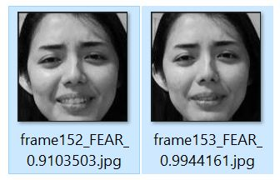
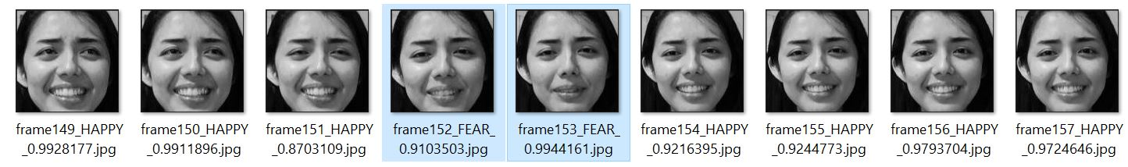
Future Works
A nervous subject displays a happy face, a ‘HAPPY’ expression is detected and at some point, the subject subconsciously displays a ‘FEAR’ expression then back to ‘HAPPY’ again.
A hidden emotion of a person is detected:
FEAR

Slide 22
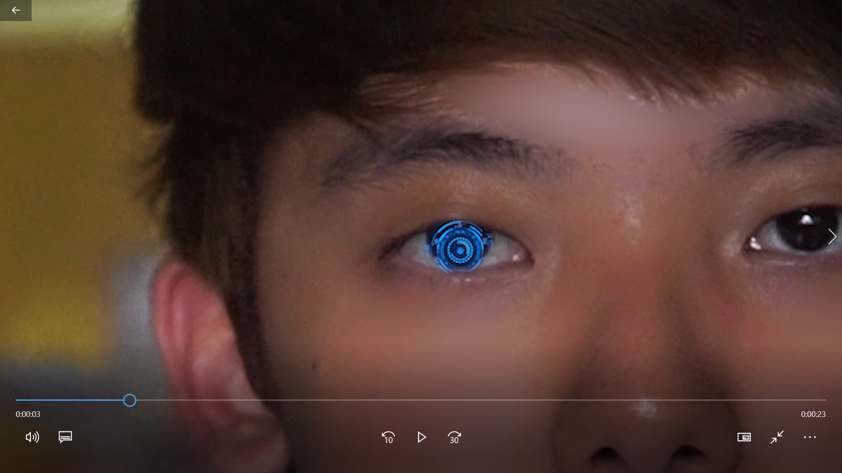
Video
Click on the Image while holding down Ctrl to watch the video on YouTube ☺

